Slide 1
DocExtract
Intelligent document processing for finance teams. Local vision model, human review, structured export.
Fazza Arrantisi data, documentation, business case
Fadhil lead dev: extraction, validation, backend, auth, RAG
Gifari Madia frontend and UI, LM Studio configuration
Yazid evaluation, performance
24 June to 30 July 2026 / 46 commits / 12 work sessions
Notes:
Open with the product name and one sentence on what it does. Name the four team members and their roles in one breath, do not read each one slowly. Then say: what you will see over the next few minutes is a pipeline that already runs, not a concept. After this deck, we move straight into the live application for the walkthrough.

Slide 2
Manual entry is slow and expensive
Baseline assumption, source docs/BUSINESS_CASE.md
Every invoice, purchase order, and receipt is retyped into the system by hand.
Header and line items both have to be copied, so one document takes 6 minutes.
Typing errors in amounts only surface at reconciliation, often after the period has closed.
Cost scales linearly with volume. Double the documents, double the hours.
The cost chain
1,000 documents
per month
6 minutes
manual keying time per document
100 hours
workload per month
Rp 50.000
staff cost per hour
Rp 5.000.000
manual entry cost per month
We are not cutting the people. We are cutting the retyping.
DocExtract 2/8
Notes:
Stay on the problem for thirty seconds before moving to the solution. Walk through the cost chain on the right in order: a thousand documents, six minutes each, a hundred hours, times fifty thousand rupiah, five million a month. This is a mid-size AP department assumption, not a number we invented, it is recorded in BUSINESS_CASE.md.

Slide 3
A vision model reads the document directly
One step, no separate OCR engine, everything runs on one machine
The image goes in, structured fields come out. No Tesseract, no PaddleOCR, no separate text-parsing stage.
React + Vite
Tailwind. Upload, review, archive,
dashboard. Presentation only.
FastAPI + pydantic
extraction, validation, export,
auth. All logic lives here.
OpenAI-compatible
chat/completions
LM Studio
qwen/qwen3-vl-4b
loaded at a 16k context.
HTTP, JSON
SQLite
documents, corrections, audit log
Images are sent as a base64 data-URI inside the image_url payload. PDFs render at zoom 3.0 via PyMuPDF first. Temperature 0 for repeatable output.
Why local: documents never leave the machine, and per-document compute cost is close to zero.
DocExtract 3/8
Notes:
This is the core slide. Read the statement as written, then pause. A classic OCR pipeline is two steps, read the letters, then guess the structure, and errors stack between them. We cut one step. Walk left to right in three sentences. React never talks to the model, it only talks HTTP to FastAPI. FastAPI calls LM Studio through an OpenAI-compatible endpoint, so swapping models later means changing a name, not rewriting code. On why local: invoices carry vendor names, document numbers, and transaction values. Running the model on our own machine means that data never reaches a third-party API.

Slide 4
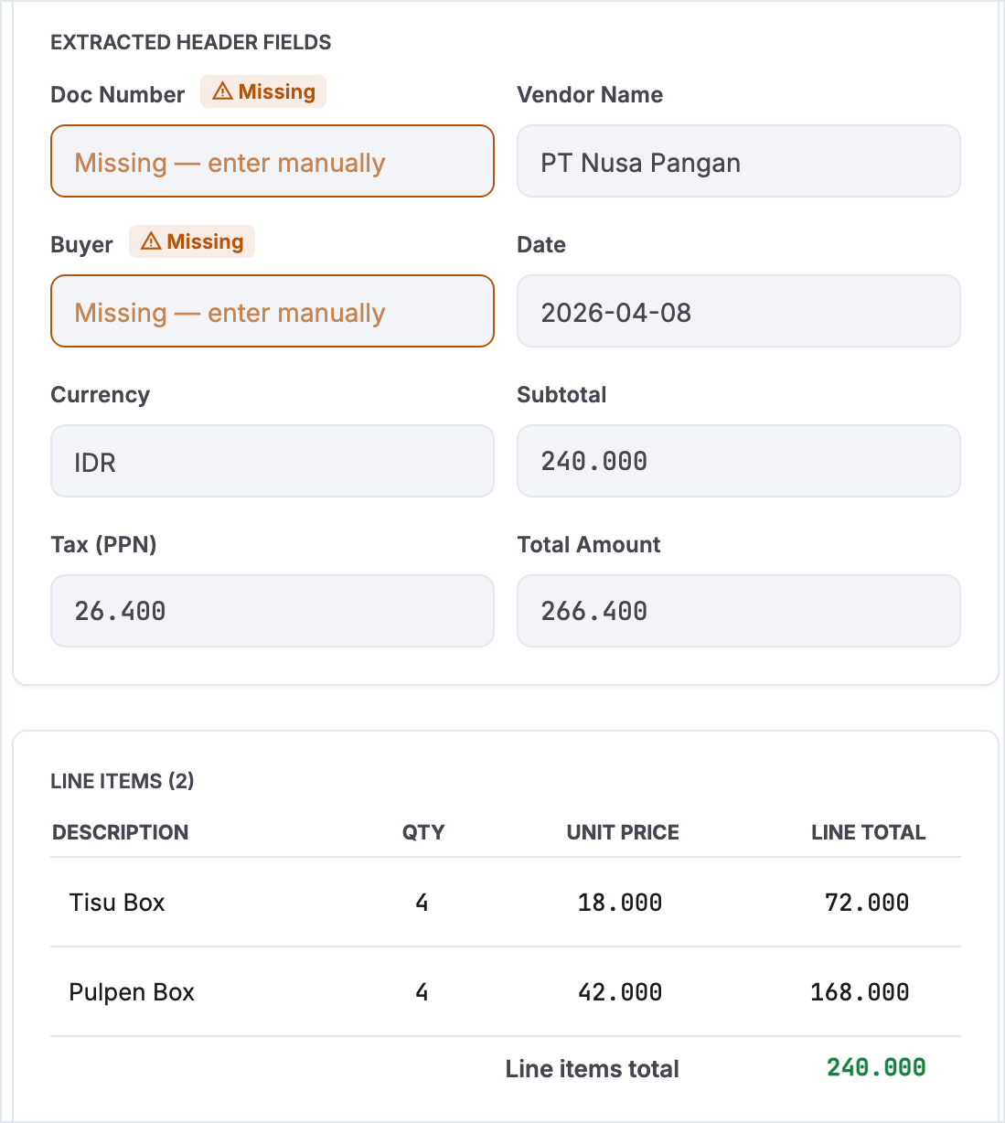
Extraction and validation
One document processed end to end, checked against 9 business rules
Upload one file or many, PDF, PNG, or JPG. Model and language are configurable in Processing Settings, not hardcoded.
9 rules split into two tiers: errors block export, warnings ask a human to look.
Errors: required fields present, subtotal plus tax equals total (a hard arithmetic contradiction).
Warnings: line items reconcile with subtotal, PPN rate check, date and currency format, document number present, per-line qty times unit price.
Subtotal 240.000, tax 26.400, total 266.400, read correctly. The prompt states that the dot is a thousands separator, with a worked example, and PDFs render at zoom 3.0.
DocExtract 4/8
Notes:
Do not read all nine rules aloud, the audience can read them. Explain the split instead: errors are arithmetic contradictions or missing required fields, no room for interpretation, so export is blocked. Warnings are things a human should look at but may still be legitimate. The panel on the right is also our answer to the Indonesian thousands-separator problem. The model used to read Rp 240.000 as 240. The fix was not regex post-processing, it was telling the prompt explicitly that the dot is a thousands separator, with an example, plus rendering PDFs at a higher zoom.

Slide 5
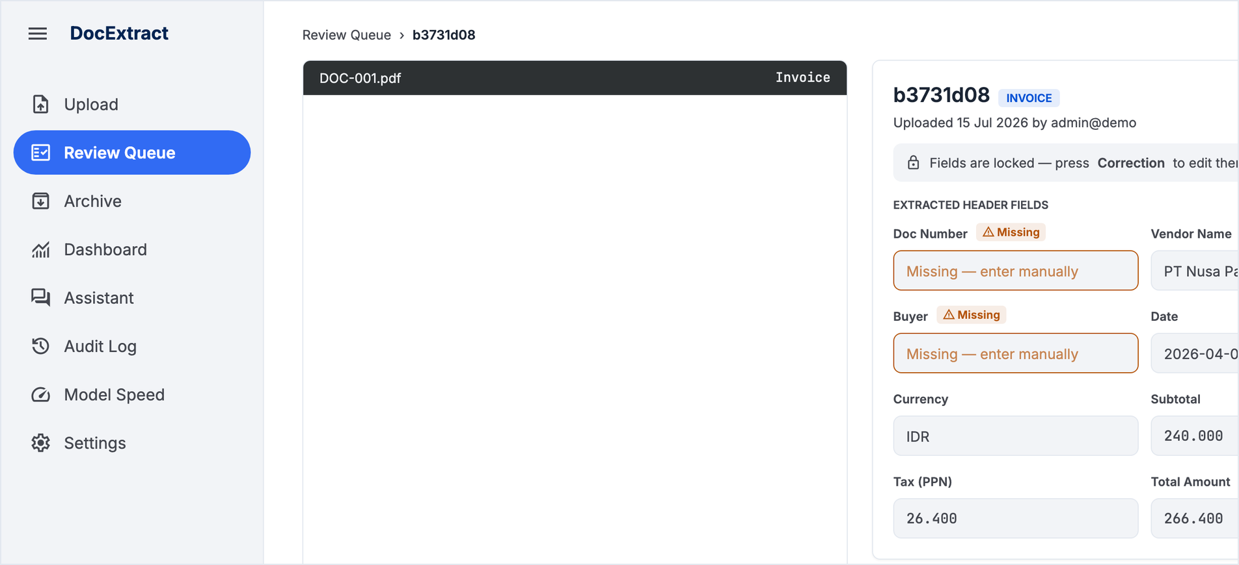
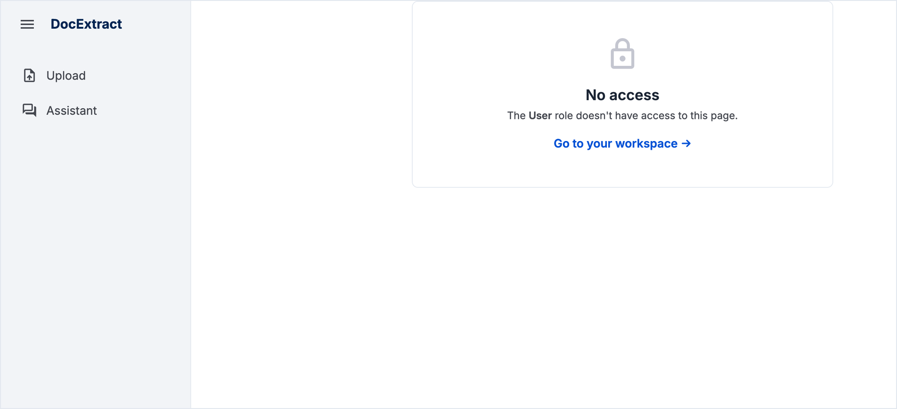
Human review and role separation
Enforced by the server, not hidden in the UI
Admin opens /review. Sidebar includes Audit Log, Model Speed, and Settings.
User opens the same URL and is denied. Sidebar only has Upload and Assistant.
user
uploads documents, sees only their own results
staff
corrects flagged fields. Cannot approve
admin
the only role that can approve. Approval is what moves a document into the Archive
DocExtract 5/8
Notes:
Two screenshots, same URL, different login, that is the fastest way to prove role separation without a long explanation. If asked whether this is just a hidden menu, be direct: no, the endpoint in FastAPI rejects the request, the No access page is a consequence of that rejection, not a UI trick. Close with the rule that matters most: staff cannot approve, and only an admin approval moves a document into the Archive.

Slide 6
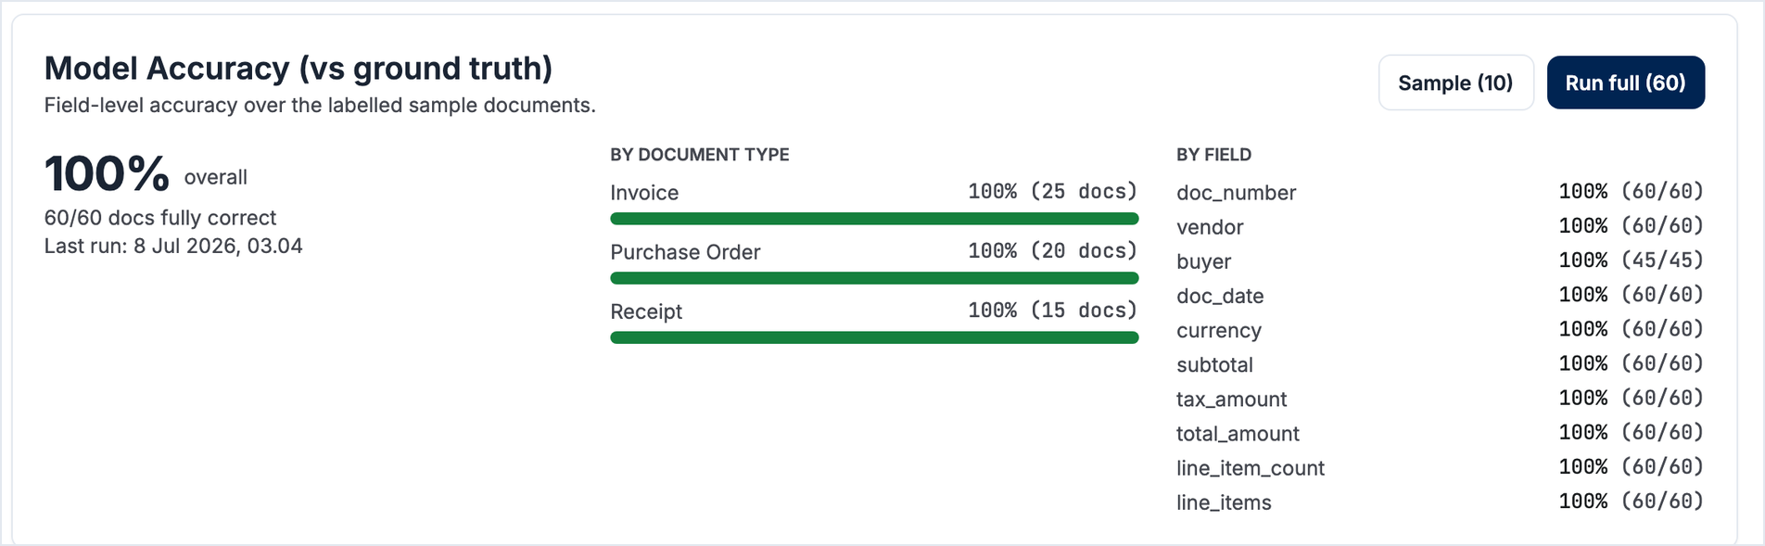
60 of 60 documents fully correct
10 fields per document, checked against data/ground_truth.csv. Split: 25 invoices, 20 purchase orders, 15 receipts. Source: data/eval_summary.json, run on 8 July 2026.
136
2
1
7
117
Pass
Fail
Not run
Empty
pytest passed
147-scenario test plan, 3.Testing Scenario_v3.0.xlsx, 57 screenshots and 2 dated logs as evidence.
DocExtract 6/8
Notes:
State the number with its denominator, do not just say 100 percent. Sixty out of sixty documents, ten fields each, evaluated on 8 July 2026, and name the file. A traceable number is stronger than an impressive one. Then move to testing without dwelling on the accuracy figure, it is addressed more carefully in the limitations slide. Name the 2 fails here too, so nothing looks hidden. The full evidence, screenshots and logs, is available in the Works folder if anyone wants to open it now.

Slide 7
Business case
docs/BUSINESS_CASE.md, conservative assumption of 20 percent of documents reviewed by a human
Rp 5.000.000
manual entry cost per month, 1,000 documents keyed in full
Rp 500.000
cost with DocExtract, 200 documents reviewed at 3 minutes each
Rp 4.500.000
saved per month, about 90 percent
Rp 54.000.000
saved per year
3.3 months
payback on the Rp 15.000.000 setup cost
Compute cost is excluded because the model runs locally on existing hardware, so per-document inference cost is close to zero.
DocExtract 7/8
Notes:
Only two numbers need to be said out loud: savings of about four and a half million rupiah a month, and payback in about three point three months. Let the rest be read. Explain where the five hundred thousand comes from: two hundred documents reviewed, three minutes each, not six, because the reviewer only confirms, never retypes from scratch. If asked whether 20 percent is realistic, be honest: it is the fallback used when no evaluation has run yet. The application itself pulls this ratio from the real evaluation result. Even at a pessimistic 50 percent review rate, cost still drops by about 75 percent.

Slide 8
What we are honest about
Four things we raise ourselves, before being asked
1
100 percent is a ceiling, not real-world performance
The evaluation ran on 60 documents from the same set used while designing the prompt. No held-out test set exists yet.
2
Two test scenarios failed
Multi-page PDF: upload and extraction both run, but only the first page is read. Unsupported file rejection: the behavior does not yet match the design.
3
7 scenarios have not been run
Running them needs either a full 30-minute evaluation pass or the model server switched off.
4
The dashboard does not auto-refresh across users
Numbers are pulled when a page opens and when a user acts. This is a deliberate choice, not a missed bug.
Thank you. From here, we continue in the live application.
Questions are welcome now or during the walkthrough.
DocExtract 8/8
Notes:
This slide decides whether the deck is trusted. Say it calmly, do not apologize, do not rush. Good opening line: that 100 percent figure looked too good, and it is, so let me explain the limit myself. For the two failures, stress that this is proof the testing is real. A test suite that is entirely green usually means the testing was not hard enough. Close briefly and move straight into the application. Do not summarize the whole deck again.

